Slide 1
Analyzing Hashimoto disorder causes, symptoms and case improvements using Topic Modeling
Sheimy Paz
Software Engineer
FGCU

Slide 2
Overview
Motivation
Model
Results
Conclusions
Takeaways from the REU Experience

Slide 3
Motivation
The motivation behind this project was aim our society providing an optimize view of the Hashimoto disorder. Notice that there are more than 200,000 cases diagnosed per year and not a clear cause identified for the disorder yet.
Bring awareness and transparency to the disorder is a decent outcome since most of the key factors like symptoms, causes, triggers are still in research therefore at least this information will provide the most accurate evidence we have until now.

Slide 4
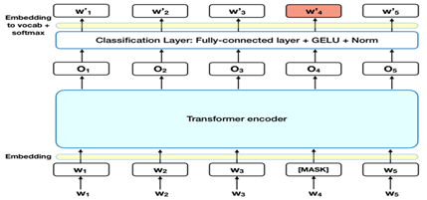
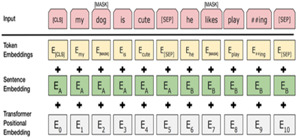
Model
We utilize deep learning BERT model to train the dataset. BERT is a superior performer Bidirectional Encoder, which superimposes 12 or 24 layers of multi headed attention in a Transformer. Bert stands for Bidirectional Representations from Transformers. Meaning that it can read from left to right and vice versa with the purpose of an accurate understanding of the meaning of each word in a sentence or document, in a manner that if a word is masked the program will still be able to understand the meaning of the sentence. The used of transformers and bidirectional models allows the learning of contextual relations between words. Notice that BERT uses two training strategies Mask Language Model and Next Sentence Prediction.
On the image we observed the two training strategies. Mask Language Model process on the left and the Next Sentence Prediction on the right.

Slide 5
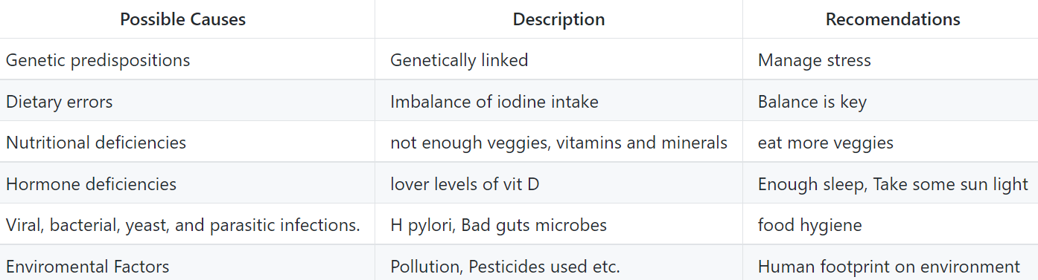
Results
Here we can see a summary table of possible causes and recommendation.

Slide 6
Conclusions
The use of AI in particular topic modeling with Bert models was precise for the analyzation of the data set used.The dataset was collected from silo breaker software, which contains information about news, reports, tweets, and blogs. With libraries like gensim we were able to manipulate the data to our convenience finding and highlighting key word and topics making the research process Optimum.
we attempt to summarize Hashimoto thyroiditis findings in aspects of causes, symptoms, recommended diets and supplements. Causes is one of the main keys, because if we know the cause of something most likely we will be able to avoid it. However, this disorder is considered relative new and have been around for some decades only, that is why it is necessary to point out the relation of diseases with the environment. Environmental changes are a fact and are affecting us every day even if we don’t notice it. We have seen an exponential increase of Hashimoto cases in the last decades, and at the same time the last decades have been potentially related to climate change, high levels of pollution, less fertile soils, increased use of pesticides on food, etc. Hence It would be a good idea to think about the environment and how to come together and fix some or all the damage we have done since it will bring benefits for all of us.

Slide 7
Takeaways from REU Experience
I would like to mention the amazing experience and skills this REU provided me. I am glad I had the opportunity to learn from all the amazing professors or mentors, each lecture was incredibly helpful and full of knowledge. I gain and improve my skills with important tools like GitHub, nano hub, machine learning, git bash, python, R, virtual machines and many more. This REU expand my understanding of these topics and AI in general.
Here is the link to the project
https://github.com/cybertraining-dsc/su21-reu-372/blob/main/project/index.md

Slide 8
Acknowledgments
I would like to thank all the staff that make possible this REU and my presence here. I was not expecting to have an opportunity like this on the summer. I am very grateful for everyone that make it possible even though I don’t know most of them or their name, but I want it to make sure to give my gratitude to everyone and in special:
Dr. Gregor von Laszewski
Dr. Yohn Jairo Parra Bautista
Dr. Carlos Theran
My peers
Florida A&M University
Florida Gulf Coast University

